Slide 1
Why Read Poetry?

Slide 2
Poetry connects people across different ages, ethnicities, economics, and time.
Example: “An Argument” by Thomas Moore (1779-1852)
I’ve oft been told by learned friars,
That wishing and the crime are one,
And Heaven punishes desires
As much as if the deed were done.
If wishing damns us, you and I
Are damned to all our heart’s content;
Come, then, at lease we may enjoy
Some pleasure for our punishment

Slide 3
Poems convey ideas through the following:
Images
Diction (word choice)
Rhyme
Rhythm (syntax = sentence structure, word order, flow)

Slide 4
Some people ask, “Why does poetry have to be so difficult?”
It is a larger thought expressed in a few words.
It is a pound of coal turned into a one carat diamond.
It is a chocolate cake turned into fudge.
It is the feeling you get that her words don’t match her eyes.

Slide 5
TIPS FOR READING POETRY
Expect to read the poem several times.
2. Read the poem aloud, or listen to someone else read it.
Be open to the fact it can have more than one meaning / translation overall, or that the meaning can shift across the poem.
-People are conflicted and contradictory, so poets may be representing that.
4. Look for specific words and lines to justify your interpretation!
5. Look up words you don’t understand ; every word counts in a poem.

Slide 6
6. Sometimes the context will help you see the literary device being
used.
-If the reference is one you do not understand, look at how it is being used.
How does the word/phrase/image fit with what the rest of the poem says to me?
7. Don’t dwell on one word!
-You may not get every little reference in the poem. Focus on what you DO understand.
8. Enjoy the poem!
-Poets want to move you (to laughter, tears, anger, joy, etc...), make you think, and let you enjoy the beauty of the complex.

Slide 7
“Introduction to Poetry” by Billy Collins
1. Read the poem one time through.
2. As you read it for the second time, go verse by verse. Beside each verse, write down the author’s message in your own words (summarize).
3. Read the poem a final time and summarize what your think the author’s main point is. Why did he write this poem?
4. Who do you think the speaker of the poem is? Who is the “they” he speaks of?
(There can be more than one answer!)

Slide 8
“Why Poetry” by Matthew Zapruder
The student sees
Metaphors of tranquility
Demolition derby detail
Alliterative futility
Fuming, “I may fail.”
Why poetry?

Slide 9
The poet sees
His muse aroused, his sleep
Denied
Three days, for one expression
That tells of history, the heart
and pride
Allowing readers its possession.
Why poetry?

Slide 10
The reader sees
With new eyes, the poet’s great
theme!
That all is one and one is all
He sees the irony supreme
His sense intrigued, his mind in thrall.
Why poetry?

Slide 11
The adult sees
Life’s random madness dance
With ironic beauty, and smirks
“Voltaire would’ve loved that.”
His wins and losses, merely quirks.
Why poetry?

Slide 12
The old man writes,
His life inferred on a page
The joys, the triumph of the soul
The knowing, the reward of age.
His grandson sighs, his young
eyes roll
“Why poetry?”

Slide 13
Popular Types of Poetry
Sonnet Free Verse Ode
Limerick Blank Verse Found poem
Lyric Acrostic Narrative
Ballad Biopoem Sonnet
Haiku Concrete Epic
Tanka Epitaph
Cinquain Catalogue (List)

Slide 14
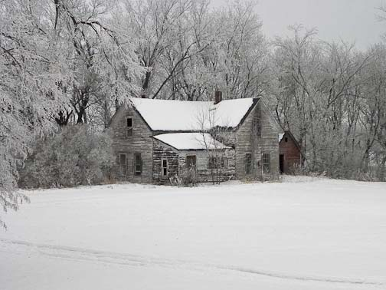
Free Verse
Example
Free Verse is an irregular form of poetry free of traditional rules of fixed meter or rhyme.
In moving from line to line, the poet's main consideration is where to insert line breaks. Some ways of doing this include breaking the line where there is a natural pause or at a point of suspense for the reader.
Those Winter Sundays by Robert Hayden Sundays too my father got up early and put his clothes on in the blueblack cold, then with cracked hands that ached from labor in the weekday weather made banked fires blaze. No one ever thanked him. I'd wake and hear the cold splintering, breaking. When the rooms were warm, he'd call, and slowly I would rise and dress, fearing the chronic angers of that house, Speaking indifferently to him, who had driven out the cold and polished my good shoes as well. What did I know, what did I know of love's austere and lonely offices?

Slide 15
Blank Verse
Example
I know not how to tell thee who I am:
My name, dear saint, is hateful to myself,
Because it is an enemy to thee;
Had I it written, I would tear the word.
A line of poetry or prose (regular speech) in unrhymed iambic pentameter (rhythm but no rhyme)
Iambic pentameter is 10 syllables, divided into 5 unstressed followed by 5 stressed syllables.

Slide 16
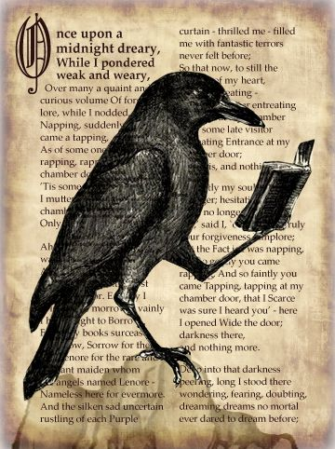
Narrative Poem
Example
Narrative poems include ballads, lyrics, and epics, and often tell of societies and heroic deeds.
They can be very dramatic when telling of a particular situation
Edgar Allan Poe “The Raven”
Once upon a midnight dreary, while I pondered weak and weary, Over many a quaint and curious volume of forgotten lore, While I nodded, nearly napping, suddenly there came a tapping, As of some one gently rapping, rapping at my chamber door.'' Tis some visitor,' I muttered, `tapping at my chamber door - Only this, and nothing more.'

Slide 17
Ballad
Example
A short narrative poem with stanzas of two or four lines and usually a refrain (chorus)
The story of a ballad can originate from a wide range of subject matter but most frequently deals with folk-lore or popular legends.
Most ballads are suitable for singing with the last words of the second and fourth lines rhyming
The Ballad of Marian Blacktree Refrain: Oh, do you know the mountain road That leads to yonder peak? A few will walk that trail alone, Their dreams they go to seek.
(I) One such was Marian Blacktree, A lowly sheperdess, And courting her was Tom, the swain, Who loved her nonetheless.
(II) A thought occurred to Marian While watching o'er her sheep, And gazing at the mountain thus she nodded off to sleep.
(Refrain)

Slide 18
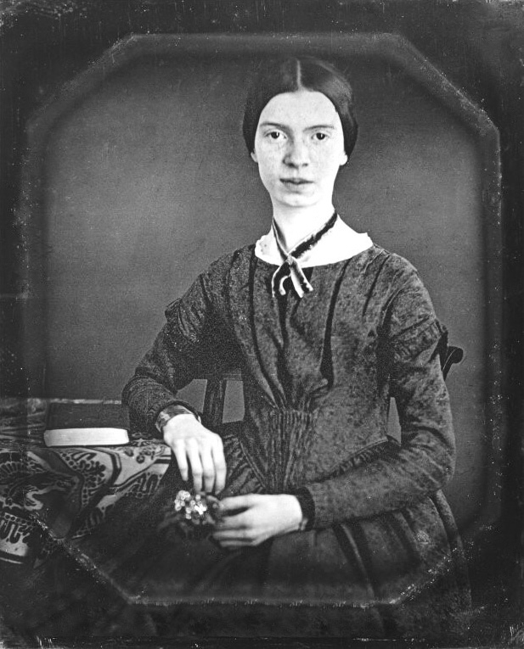
Lyric
In lyrical poetry, the mood is musical and emotional. The writer of a lyric poem uses words that express his state of mind, his perceptions, or his feelings.
Many lyric poems are about love, but they can be about anything which stirs the emotions.
Some of the best examples of lyric poetry are sonnets.
Emily Dickinson
This example of lyric poetry is a poem by Emily Dickinson named “I Felt a Funeral in my Brain.” It describes a person who is going insane, or thinks they are:
I felt a Funeral, in my Brain, And Mourners to and fro Kept treading - treading - till it seemed That Sense was breaking through - And when they all were seated, A Service, like a Drum -Kept beating - beating - till I thought My Mind was going numb -

Slide 19
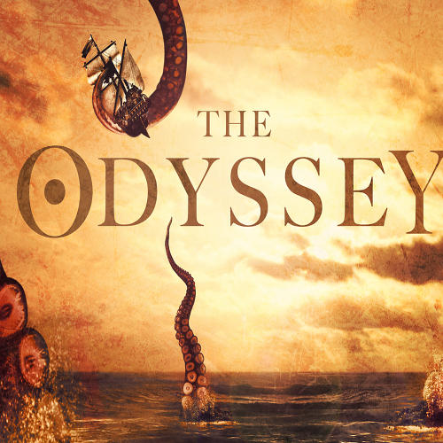
EPIC
Excerpt
A long narrative poem celebrating the adventures and achievements of a hero...epics deal with the traditions, mythical or historical, of a nation.
For example, The Odyssey centers on the Greek hero Odysseus and his journey home following the fall of Troy. I
In the very first line Homer, the author, says, "Sing in me, Muse, and through me tell the story" which is then followed by an explanation of the theme. The introduction of the muse and the theme statement are both major characteristics of an epic.
Homer also begins in the middle of the story, which is characteristic of an epic as well.
Another epic characteristic that can be found is the largeness of the setting. "The Odyssey's" setting spans out in great distances, and Odysseus travels to many different places on his way back to Ithaca.

Slide 20
Sonnet
Example:
Sonnet 130
A fourteen line poem in iambic pentameter
A Shakespearean sonnet is composed of 3 quatrains (lines of 4) and a couplet (2 rhyming lines)
The rhyme scheme is:
abab
cdcd
efef
g g
* Sonnets end with a couplet which sums up the meaning of the poem
My mistress' eyes are nothing like the sun; Coral is far more red, than her lips red: If snow be white, why then her breasts are dun; If hairs be wires, black wires grow on her head. I have seen roses damasked, red and white, But no such roses see I in her cheeks; And in some perfumes is there more delight Than in the breath that from my mistress reeks. I love to hear her speak, yet well I know That music hath a far more pleasing sound: I grant I never saw a goddess go, My mistress, when she walks, treads on the ground: And yet by heaven, I think my love as rare, As any she belied with false compare.

Slide 21
How Words are Accented Does Matter
Names
`Nicole `Daniel Den`zel
Ni`cole Dan`iel `Denzel
British American
`adult a `dult
ad`vertisment adver `tisement
`ba llet ba`llet
`garage ga `rage
‘vaccine va `ccine

Slide 22
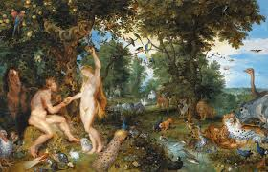
Poetic Techniques
Endstop
Nature’s first green is gold,
Her hardest hue to hold.
Her early leaf’s a flower;
But only so an hour.
Then leaf subsides to leaf.
So Eden sank to grief,
So dawn goes down to day.
Nothing gold can stay.
Enjambment
My apple trees will never get across
And eat the cones under his pines, I tell him.
Before I built a wall I’d ask to know
What I was walling in or walling out

Slide 23
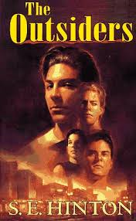
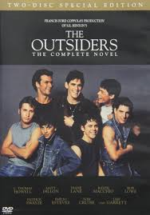
The Outsiders by SE Hinton
“ ‘Stay gold, Ponyboy. Stay gold..’ ”(148).
https://www.youtube.com/watch?v=cOwPaC3ZaQQ
1983
Rob Lowe
Tom Cruise
Patrick Swayze
Ralph Macchio
Emilio Estevez

Slide 24
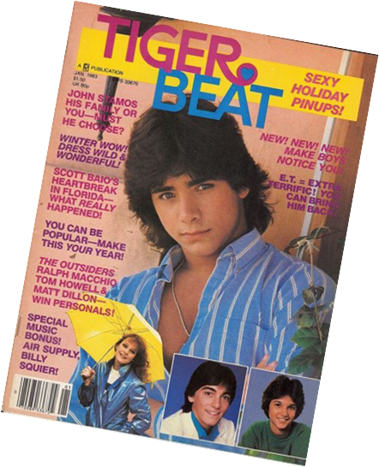
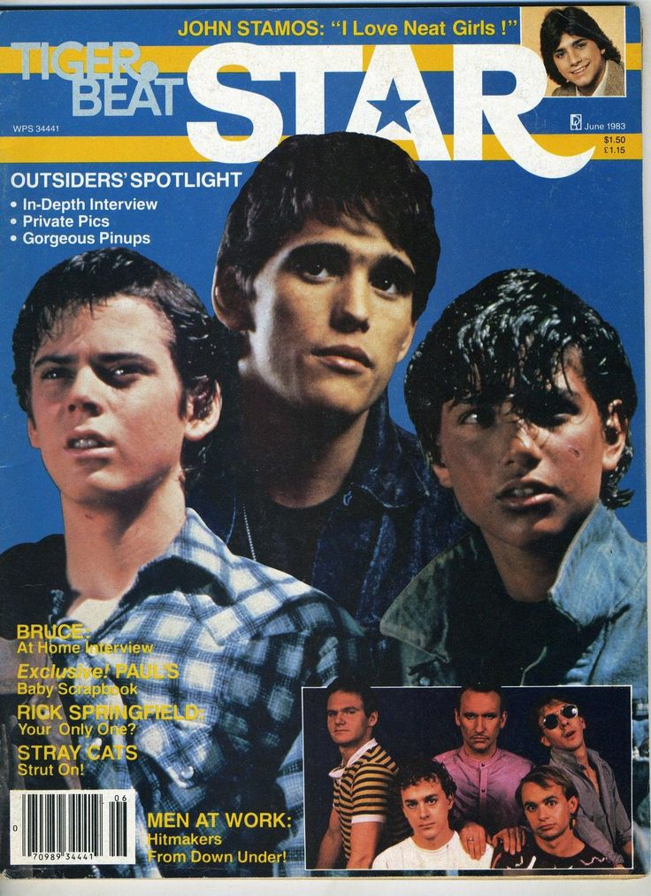
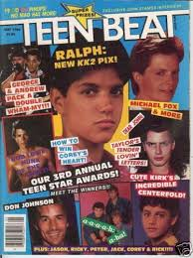

Slide 25
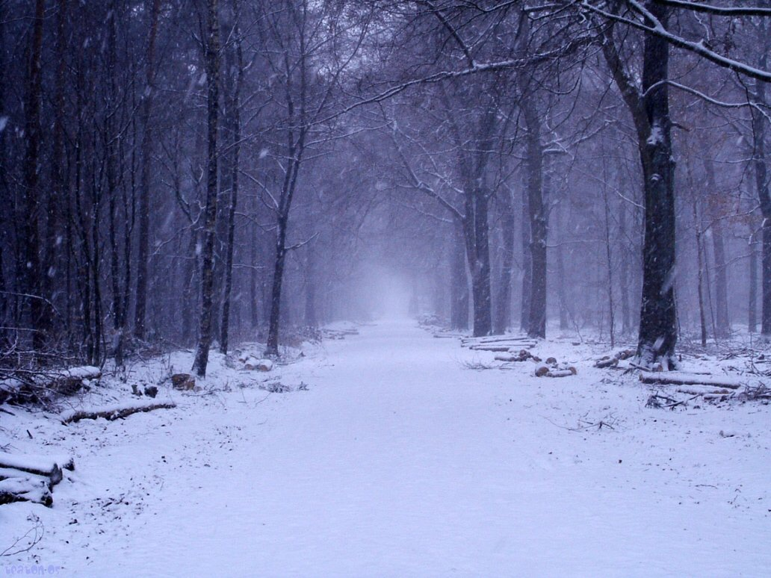
What is End Rhyme and Internal Rhyme?
-End rhyme is when words at the ends of the lines rhyme, like in “Stopping by Woods on a Snowy Evening”
Whose woods these are I think I know.
His house is in the village though;
-Internal rhyme is when words in the middle of lines rhyme
Once upon a midnight dreary, while I pondered, weak and weary,
While I nodded, nearly napping, suddenly there came a tapping,
As of someone gently rapping, rapping at my chamber door.
Tis some visitor,” I muttered, “tapping at my chamber door…..
Ah, distinctly I remember it was in the bleak December;
And each separate dying ember wrought its ghost upon the floor.
Eagerly I wished the morrow; – vainly I had sought to borrow
From my books surcease of sorrow – sorrow for the lost Lenore…
“The Raven” Edgar Allen Poe

Slide 26
Repetition:
Repeating a word (or words) for effect
Example:
“Alone” by Maya Angelou
Nobody
No, nobody
Can make it out here alone.
Alone, all alone
Nobody, but nobody
Can make it out here alone.

Slide 27
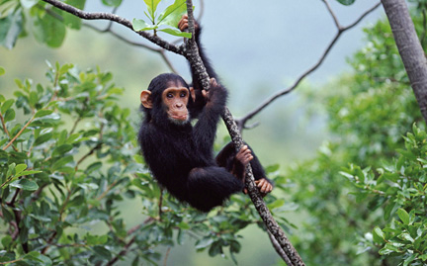
Consonance -a poetic device
characterized by the repetition of
the same consonant sound two or more
Times close together, usually at
the end of words
Example:
All mammals named Sam are clammy.
Assonance – Repetition of vowel sounds
Example:
In granite lipped basins

Slide 28
Alliteration is a type of consonance.
Alliteration – repetition of initial consonant sounds
I must go down to the seas again, to the vagrant gypsy life,
To the gull’s way and the whale’s way where the wind’s like a whetted knife
“Sea Fever” Masefield
Anaphora – repetition of words at the start
of 2 or more sentences or verses
If you can think – and not make thoughts your aim
If you can meet with Triumph and Disaster
And treat those two imposters just the same;
If you can bear to hear the truth you’ve spoken. (2-5)

Slide 29
How to cite poetry:
If you are citing 3 lines or fewer, use quotation marks and / to indicate
a line break
Frost is commenting on how nature views man’s boundaries
when he says, “Something there is that doesn’t love a wall / That
sends the frozen-ground swell under it, / And makes gaps even
two can pass abreast.” (1-3)

Slide 30
Indent quotations of four or more lines.
These quotations should be indented 1 inch from the left margin. Do not add
quotation marks for a long quote.
Add the line numbers inside parentheses right after the closing punctuation
of the quotation. Do not put another comma after the in-text citation.
Use a colon after a complete sentence that introduces a quotation to avoid
a comma splice.
Example: Robert Frost writes about solitude and man’s relationship with
nature:
Whose woods these are I think I know. His house is in the village, though; He will not see me stopping here To watch his woods fill up with snow. (1-4)

